Slide 1
K-Means Clustering for Patient Segmentation in Heart Disease Diagnostics
Student's Name
Institutional Affiliation
Course
Professor's Name
Date

Slide 2
Presentation Overview
Introduction
Data Loading
Data Preprocessing
Performing of Exploratory Data Analysis (EDA)
Model Building (K-Means Clustering)
Model Evaluation and Cluster Analysis
Results
Conclusion

Slide 3
Introduction
Focus on K-Means Clustering for patient segmentation using a heart disease dataset.
Patient segmentation aids in personalized care and resource optimization.
Goal: Classify patients based on risk factors to identify patterns and improve healthcare decisions.
Clustering helps recognize high-risk groups for targeted interventions and efficient diagnostics.
Notes:
This project is particularly interested in K-Means Clustering for patient segmentation with particular reference to heart disease data sets. Patient classification is another efficient way to sort out patients according to individual attributes and particularities, thus achieving a more practical approach to individual patient management and a more efficient distribution of resources within a healthcare system. The goal is to examine patient clusters to optimize diagnostics and facilitate health care for patients likely to develop heart disease.

Slide 4
Dataset Columns
Dataset used is (heart.csv) includes features like;
age: Patient's age
sex: Gender (1 = male, 0 = female)
cp: Chest pain type
trestbps: Resting blood pressure
chol: Cholesterol level
fbs: Fasting blood sugar
Restecg: ECG results (0-2)
thalach: Max heart rate
Exang: Exercise-induced angina (1 = yes, 0 = no)
Oldpeak: ST depression from exercise
slope: Slope of ST segment
ca: Major vessels colored by fluoroscopy (0-3)
thal: Thalassemia type (0-2)
target: Heart disease presence (1 = yes, 0 = no)
Notes:
The specific dataset used in this project is heart.csv and deals exclusively with heart disease. In this case, the table has several essential columns which reflect the main parameters of a patient’s medical record. These columns are age (age), gender (sex), chest pain type (cp), resting blood pressure (trestbps), cholesterol levels (chol), fasting blood sugar (fbs), electrocardiographic results (restecg), maximum heart rate (thalach), exercise-induced angina (exang), ST depression induced by exercise predicted from ST segment at peak exercise (oldpeak), the slope of the peak exercise ST segment, number of major The label for prediction is given in the target column which denotes if the patient had heart disease or not. It is possible to explain these features to categorize patients better and determine their susceptibility to heart disease.

Slide 5
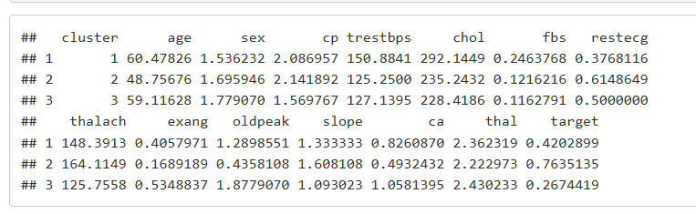
STEPS USED IN THE PROJECT
Step 1 :Data Loading
Import basic R packages for data manipulation, visualization and clustering analysis.
Data manipulation should be done by dplyr, and ggplot can be used for data visualization.
Used cluster and factoextra libraries to perform and display the outcome of performing K-Means Clustering.
Using the read.csv(), read the heart disease dataset and then use the head() function to view the dataset's structure.
Figure shows summary of data.
Notes:
This step entails the essential R libraries we need to prepare the data for analysis. Such packages are dplyr to perform different operations about data manipulation and ggplot2 to perform different operations about data visualization, respectively. Clustering uses the cluster and factoextra library to perform and analyze the K-Means. In the current study, the heart disease dataset is included in the data frame format, with the filename “heart.csv” The head function displays the first several Records within the data frame to understand the structure and properties of the data before analysis.

Slide 6
Step 2: Data Preprocessing
To find and handle the missing values use sum(is.na()).
Transform some variables which are categorical variables such as ‘sex’ and ‘cp’ into factors for analysis.
Standardize /normalize numerical fields such as age, blood pressure, cholesterol etc.
Append the scaled numerical data with the actual data to increase generalization.
Notes:
This is a process of preparing the dataset for analysis in the different phases of data mining. First, the presence of any missing values is assumed by using the sum(is. na()) function. Some variables like ‘sex’ and ‘cp’ are then transformed from categorical into factor variables for simplicity of analysis. To maintain an equal scale of data input, the quantitative variables (age and cholesterol) are also scaled using the scale() function. Finally, the scaled features are concatenated with the initial dataset for other downstream analyses.

Slide 7
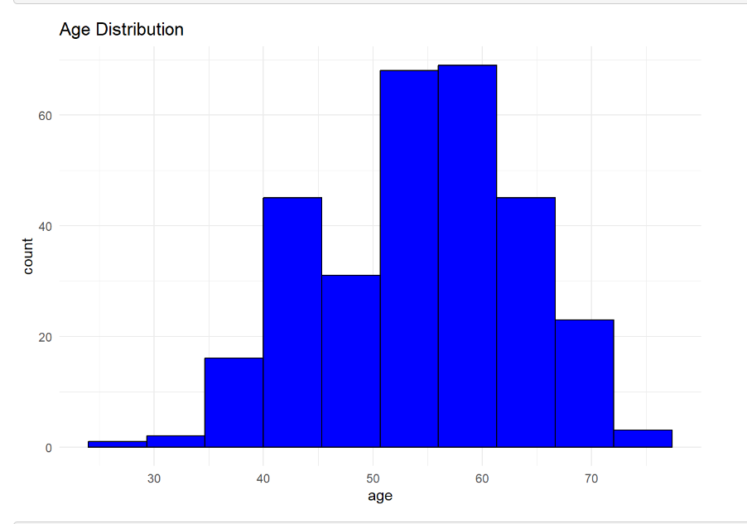
# Step 3: Exploratory Data Analysis (EDA)
Histograms are used to determine how the age is distributed within the given dataset.
Use boxplots to compare cholesterol levels in patients with and without heart disease.
Notes:
Exploratory Data Analysis, or EDA, is the third and last step and is performed in order to familiarize oneself with data patterns and associations. Distribution of age using the histogram shows variation in the age of patients, most of whom are between 50 and 60 years. Boxplot depicts the distinction in cholesterol between those with and without heart disease and the distribution of the patients on either side.

Slide 8
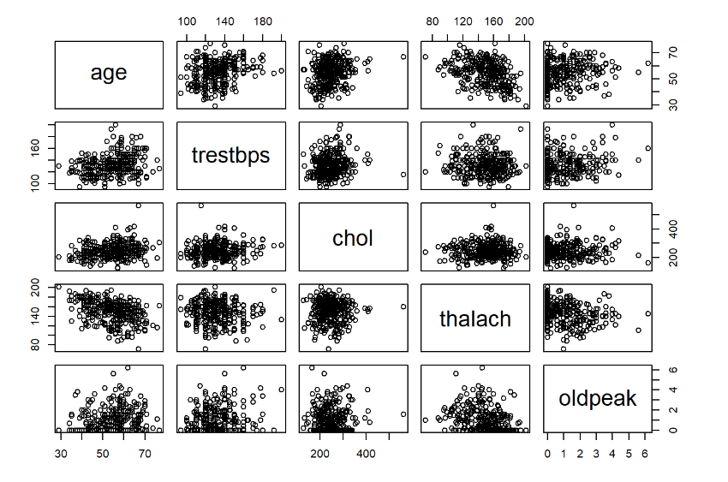
Cont.Exploratory Data Analysis (EDA)
Employ pair plots for multiple numerical age, blood pressure, and cholesterol characteristics.
The pair plot allow for the understanding of attributes that are related to each other in different patient segments
Emphasis on going beyond the averages and examining variances to learn more about the data.
Notes:
In other words, pair plots are employed whenever one wishes to analyze the dependencies of multiple numerical variables, for example, age, blood pressure, cholesterol levels. This makes it possible to discover patterns of the features in relation to each other since it is not easy to discover this from numerical measures alone. Unlike other statistical means, the pair plot also considers variance and distribution which will allow the understanding of how these attributes are related to each other in different patient segments, and specifically, patients with and without heart diseases.

Slide 9
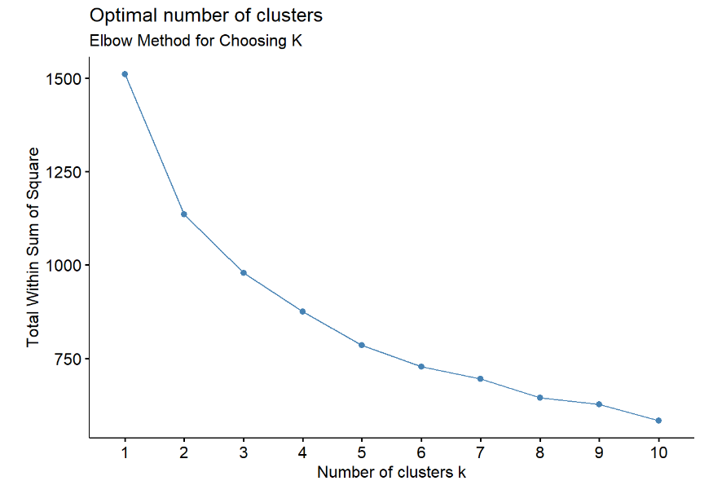
Step 4: Model Building (K-Means Clustering)
Optimal K Identified: Elbow Method determined K=3 as the ideal number of clusters for minimal variance.
Cluster Separation: K-Means algorithm grouped data into 3 clusters based on normalized values.
Cluster Assignments: Data points were categorized and stored in the dataset for analysis.
Efficient Processing: Used fviz_nbclust for visualizing and validating the elbow point.
Analysis Ready: Updated dataset facilitates insights from distinct cluster patterns.
choosing k=3 is enough for the reasonable cluster separation for further analysis as shown in the graph
Notes:
Applying the Elbow Method, the value for K equals 3, maintaining the cluster variance in perspective. The K-Means algorithm partitions the data into three very different groups, adding their forecasts to the data sets. The WSS plot confirms the selected K value so that there will be more efficient clusters in the current data set. This process prepares the data for additional analysis and devises insights concerning discovered clusters.

Slide 10
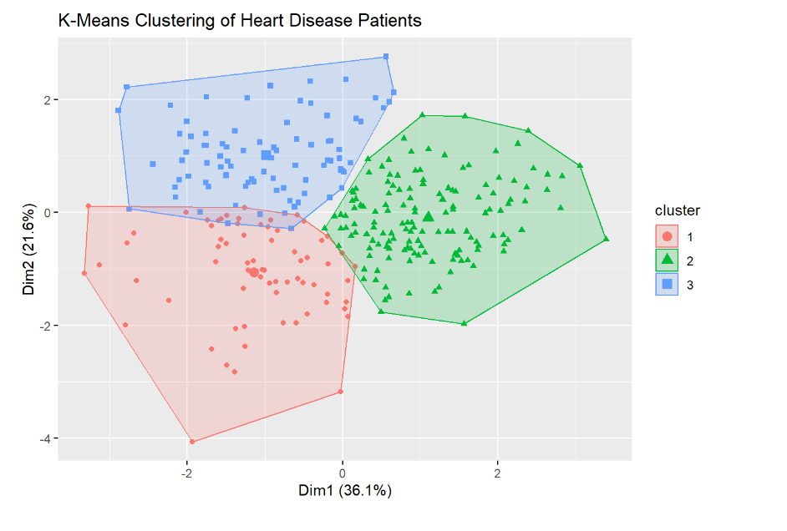
Step 5: Model Evaluation and Cluster Analysis
K-means clustering divides heart disease patients into three clusters based on two dimensions: Dim1 and Dim2.
Cluster 1 (red circles) overlaps with other clusters, located in the bottom left.
Cluster 2 (green triangles) is distinct, positioned centrally.
Cluster 3 (blue squares) slightly overlaps in the top left, with Dim1 and Dim2 explaining 36.1% and 21.6% of the variance, respectively as shown in the diagram.
Notes:
The K-means clustering categorizes the patients suffering from heart diseases into three clusters based on two features, namely Dim1 and Dim2. The data forms a partial overlap with the clusters formed, while Cluster 2 is relatively less similar to these clusters, so it can well be treated as a sub-cluster. In Cluster 3, there needs to be more intersections. The first and second dimensions explain 36.1% and 21.6% of the variation in the patients’ classification. It was also obtained that some patients have characteristics from more than one group of the eight abovementioned patients.

Slide 11
Result/Findings
Cluster 1: High age (60.48), Cholesterol level (292.14), moderate blood pressure (150.88), low exercise-induced angina (0.41).
Cluster 2: Youngest cluster with a higher maximum heart rate (164.11), lower cholesterol rate (225.24) slightly higher fast blood sugar rate (0.12) .
Cluster 3: Less prevalence of oldness (mean age 59.11) Intermediate values for cholesterol (228.41), blood pressure (127.13), and exercise-induced angina (0.53).
Thus, based on our results, Cluster 2 has the highest incidence of heart disease (0.76), while Cluster 3 has the lowest (0.27).
It assists in the development of differential treatment plans based on patient characteristics.
Notes:
The clusters show different natures of patients with heart disease. Cluster 1 is older with higher cholesterol levels and moderate BP. Cluster 2, the youngest people among the participants of the study, has increased physiological parameters of cardiovascular risk – higher heart rate and lower cholesterol levels, but higher fasting blood glucose level. Cluster 3 has moderate cholesterol, slightly lower sys BP, and is more afflicted with exercise-induced angina. It shows that Cluster 2 patients have the highest rate of heart disease and can be helpful for further treatment of different groups of patients.

Slide 12
Conclusion
Using K-Means clustering, heart disease patients may be appropriately grouped based on medical characteristics.
The number of clusters derived from applying the elbow method equated to K=3 indicated three clusters.
The assessment of the silhouette score depicted a poor and inadequate clustering quality.
The characteristics of the clusters also differed in terms of age, cholesterol, and angina provoked by exercise.
Patient segmentation can help determine how to target healthcare-related interventions or distribute resources.
Notes:
Therefore, this study establishes using K-Means Clustering to partition patients according to specific health characteristics, including age, cholesterol, blood pressure, and other characteristics relating to heart disease. Using the elbow method to decide the number of clusters, the analysis revealed three clusters of patients. Every cluster had features that would help specify patient types and adjust the healthcare treatments. However, based on matching criteria analysis and silhouette analysis, the conclusion is that there needs to be better clustering quality. However, the results can be further beneficial to understanding patient segmentation and, thus, more effective healthcare interventions for patients with heart disease.

